Slide 1

Smart Data Analytics
Wolfgang K. Härdle
Cathy Yi-Hsuan Chen
Linxi Wang

Slide 2
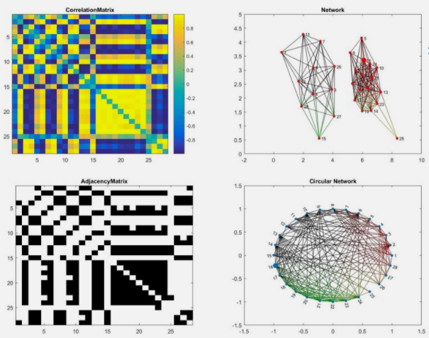


Smart Data Analytics

Slide 3
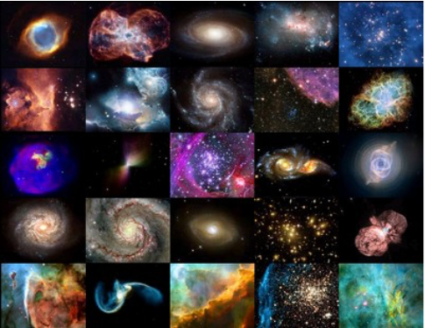
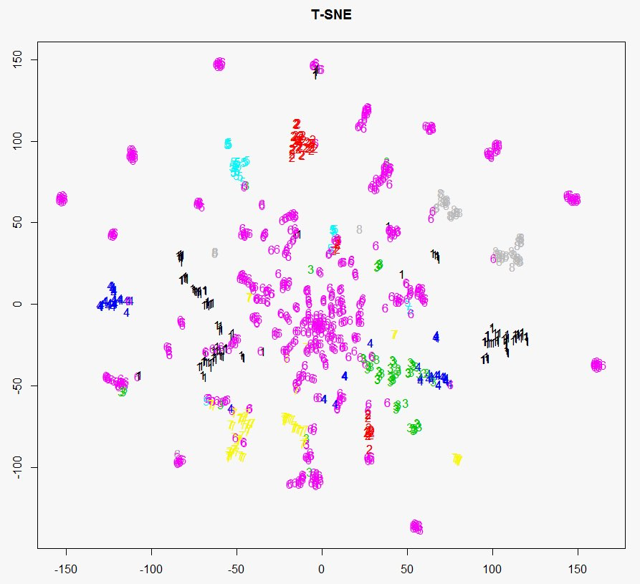
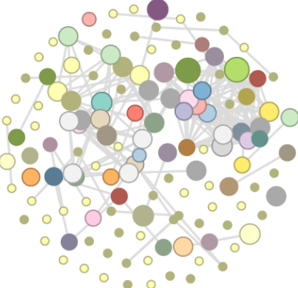
Seek and ye shall find

Slide 4
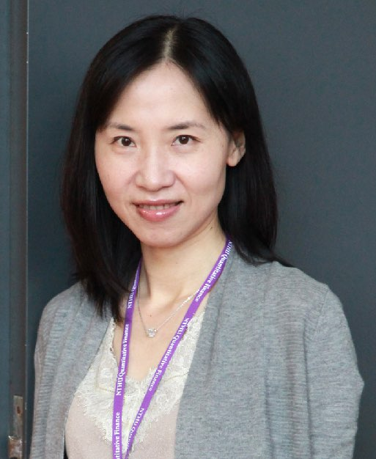
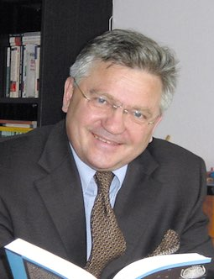
Smart Data Analytics
欢迎来到我的网页 hu.berlin/wkh !
沃夫冈是柏林洪堡大学经济商学院的终身教授，
统计与计量研究所以及数据研究中心主任，
同时兼任IRTG项目的总负责人,
厦门大学的外籍专家教授。
欢迎来到我的网页 hu.berlin/29692 !
陈怡璇 柏林洪堡大學教授
International Research Training Group 1792 成員
新加坡管理大學訪問學者

Slide 5
Smart Data Analytics - outline
1 - What do we see?
Basic concepts
Data Management
Structuring Data
2 - Data Analysis
Sentiment extraction
Stemming, lemmatizing
DTM Dynamic Topic Modeling
3 - Modern Data Analytics
Analysis and Classification
TEDAS TED Asset Allocation
CRIX CRypto currency IndeX
4 - Smart Data Analytics
R tools for text mining
Text mining in Finance
Applications & Empirics
5 - Smarter Data Analytics
Network Geometry
Tail Event driven Network AR
DYTEC Dynamic Tail Event Curves
6 - Excellent Data Analytics
Financial Risk Meter
DDI Networks Topology
Q3 D3 LSA
Notes:
20161215 Shanghai C YH Chen, W K Härdle
45 min a crash course in R from BCS slides, see LvB Metis (CC)
30 min Quantlet introduction
45 min CRIX (WKH)
45 min Econometrics of CRIX (CC)
60 min SDA Text Scraping + Classification (CC)
45 min SDA SVM (WKH)
60 min Distillation of news flows + sector specific sentiments (CC)
45 min SDA Dynamic Topic Modelling (WKH)
45 min SDA applications (WKH+CC)
45 min TEDAS TED Asset Allocation (WKH)
45 min Tail Event driven Network AR

Slide 6
SDA Smart Data Analytics - WISE, Xiamen, China
20171013 Xiamen 1021 C YH Chen, WK Härdle
a crash course in R from BCS (WKH)
Quantlet introduction (WKH)
CRIX a CRypto currency IndeX (WKH)
Econometrics of CRIX (CC)
SDA Text Scraping + Classification (CC)
SDA SVM (WKH)
Distillation of news flows + sector specific sentiments (CC)
SDA Dynamic Topic Modelling (WKH)
SDA applications (WKH+CC)
TEDAS TED ASset allocation (WKH)
Tail Event driven Network Auto Regression (WKH)
Notes:
20161215 Shanghai C YH Chen, W K Härdle
45 min a crash course in R from BCS slides, see LvB Metis (CC)
30 min Quantlet introduction
45 min CRIX (WKH)
45 min Econometrics of CRIX (CC)
60 min SDA Text Scraping + Classification (CC)
45 min SDA SVM (WKH)
60 min Distillation of news flows + sector specific sentiments (CC)
45 min SDA Dynamic Topic Modelling (WKH)
45 min SDA applications (WKH+CC)
45 min TEDAS TED Asset Allocation (WKH)
45 min Tail Event driven Network AR

Slide 7
Section 1: Text Extraction
Text Extraction - Scrape
Title from NASDAQ website
library(RCurl)
library(XML)
url = "http://www.nasdaq.com/aspx/stockmarketnewsstoryprint.aspx?storyid=3-disastrous-mistakes-mcdonalds-should-regret-cm406246"
html = readLines(url, encoding = "UTF-8")
html = htmlParse(html, encoding = "UTF-8")
xp = "//*[@id='box_content']/span/h1/text()"
title = unlist(xpathApply(html,path=xp,fun = xmlValue))
title
[1] “3 Disastrous Mistakes McDonald’s Should Regret"

Slide 8
Section 1: Text Extraction
Text Extraction - Scrape
Top 5 lines of the web page (html code)
library(RCurl)
library(XML)
url = "http://www.nasdaq.com/aspx/stockmarketnewsstoryprint.aspx?storyid=3-disastrous-mistakes-mcdonalds-should-regret-cm406246"
html = readLines(url, encoding = "UTF-8")
length(html)
[1] 346
head(html, 5)
[1] ""
[2] "<!doctype html>"
[3] "<html>"
[4] "<head>"
[5] "<title>3 Disastrous Mistakes McDonald’s Should Regret - NASDAQ.com</title>"

Slide 9
Section 1: Text Extraction
Text Extraction - Scrape
5 abstracts from SFB website
library(RCurl)
library(XML)
library(bitops)
library(stringr)
Number = paste("00",1:5,sep = '')
url = paste("http://sfb649.wiwi.hu-berlin.de/fedc/DP_abstract.php?id=SFB649DP2016",
"-", Number,".pdf", sep = '')
abs = lapply(url, FUN = function(x) htmlParse(x, encoding = "Latin-1"))
clean_txt = function(x) {
cleantxt = xpathApply(x, "//body//text()
[not(ancestor :: script)][ not(ancestor :: style)]
[not(ancestor :: noscript)] " ,xmlValue)
cleantxt = paste(cleantxt, collapse="\n")
cleantxt = str_replace_all(cleantxt, "\n", " ")
cleantxt = str_replace_all(cleantxt, "\r", "")
cleantxt = str_replace_all(cleantxt, "\t", "")
cleantxt = str_replace_all(cleantxt, "<br>", "")
return(cleantxt)
}
cleantxt = lapply(abs,clean_txt)
vec_abs = unlist(cleantxt)

Slide 10
Section 1: Text Extraction
Text Extraction - Scrape
Abstract:
This paper presents presents presents a fractionally cointegrated vector autoregression (FCVAR) (FCVAR) (FCVAR) (FCVAR) model to examine to examine to examine to examine to examine to examine to examine various relations between stock returns and downside risk…
Abstract:
In this paper we investigate transmission and spillovers of local and foreign economic policy uncertainty shocks to unemployment in two largest economic regions in the world - the United States (US) and the Euro area (EA). For this purpose we deploy Bayesian Markov-switching…
Abstract:
We study a college admissions problem in which colleges accept students by ranking students efforts in entrance exams. Students ability levels affect the cost of their efforts. We solve and compare the equilibria of centralized college admissions (CCA) where students apply to all colleges and decentralized college…
Abstract:
In this paper, we study the statistical properties of the moneyness scaling transformation
by Leung and Sircar (2015). This transformation adjusts the moneyness
coordinate of the implied volatility smile in an attempt to remove the
discrepancy between the IV smiles for levered and unlevered ETF options…

Slide 11
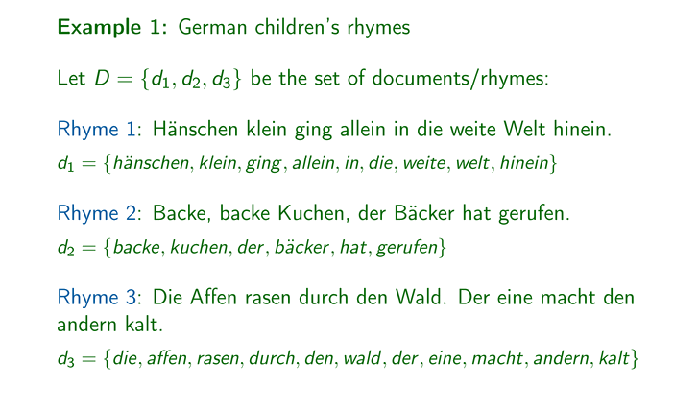
Section 2: Basic Text Analytics
Text Mining - Explore
Create a corpus & Term Document Matrix

Slide 12
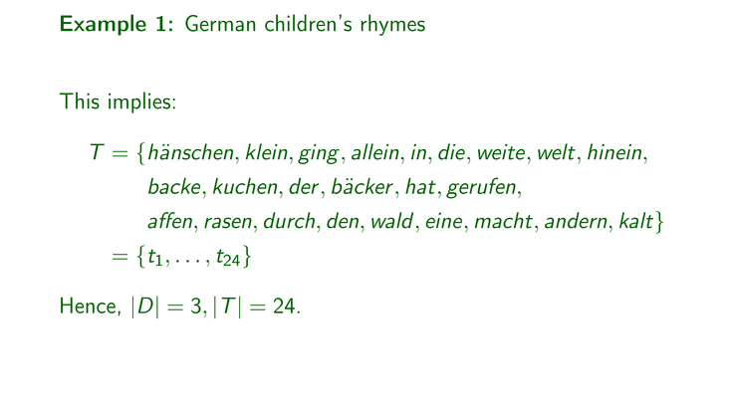
Section 2: Basic Text Analytics
Text Mining - Explore
Create a corpus & Term Document Matrix

Slide 13
Section 2: Basic Text Analytics
Text Mining - Explore
Create a corpus & Term Document Matrix
library(tm)
library(SnowballC)
abs = Corpus(VectorSource(vec_abs))
abs_dtm = DocumentTermMatrix(abs, control = list(
stemming = TRUE, stopwords = TRUE, minWordLength = 3,
removeNumbers = TRUE, removePunctuation = TRUE))
dim(abs_dtm)
[1] 5 283
inspect(abs_dtm)
<<DocumentTermMatrix (documents: 5, terms: 283)>>
Non-/sparse entries: 324/1091
Sparsity : 77%
Maximal term length: 18
Weighting : term frequency (tf)

Slide 14
Section 2: Basic Text Analytics
Text Mining - Explore
Find the words that occur more than 3 times
findFreqTerms(abs_dtm, 3)
[1] “abil" "abstract" "cca" "colleg" "compar"
[6] "construct" "dca" "downsid" "dynam" "econom"
[11] "effect" "examin" "fcvar" "find" "flexibl"
[16] "foreign" "german" "impli" "key" "labor"
[21] "leverag" "local" "long" "market" "model"
[26] "money" "notion" "paper" "parttim" "possibl"
[31] "present" "reflect" "returns" "risk" "shock"
[36] "smile" "stock" "strategi" "structur" "student"
[41] "support" "uncertainti" "valu" "vector" "videnc"
[46] "volatil" "wage" "wherea" "words"

Slide 15
Section 2: Basic Text Analytics
Text Mining - Explore
Remove sparse terms
removeSparseTerms(abs_dtm, 0.5)
inspect(removeSparseTerms(abs_dtm, 0.5))
<<DocumentTermMatrix (documents: 5, terms: 8)>>
Non-/sparse entries: 31/9
Sparsity : 22%
Maximal term length: 8
Weighting : term frequency (tf)
Terms
Docs abstract find key market model paper support words
1 1 1 1 5 1 1 3 1
2 1 1 1 0 1 1 0 1
3 1 1 1 0 0 0 1 1
4 1 0 1 2 2 2 0 1
5 1 0 1 4 0 1 1 1

Slide 16
Section 2: Basic Text Analytics
Text Mining - Explore
Explore the first five abstracts
library(ggplot2)
library(wordcloud)
freq = colSums(as.matrix(abs_dtm))
wf = data.frame(word=names(freq), freq=freq)
plot = ggplot(subset(wf, freq>15), aes(word, freq))
plot = plot + geom_bar(stat="identity")
plot = plot + theme(axis.text.x=element_text(angle=45, hjust=1))
plot
freq = colSums(as.matrix(abs_dtm))
dark2 = brewer.pal(6, "Dark2")
wordcloud(names(freq), freq, max.words=100, rot.per=0.2, colors=dark2)

Slide 17
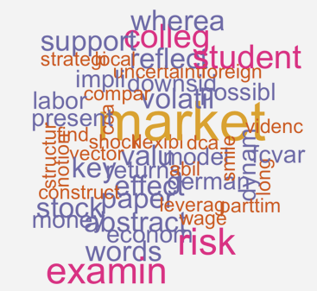
Section 2: Basic Text Analytics
Text Mining - Explore
Wordcloud
Word cloud generated from SFB webpage
Smart_Data_Analytics.R

Slide 18
Section 2: Basic Text Analytics
Text Analytics - Dictionaries & Lexica
Different dictionaries
A reference source
Containing words usually alphabetically arranged
Examples: Financial Sentiment Dictionary (LM), Loughran and McDonald (2011)
Lexica
Opinion Lexicon (BL), Hu and Liu (2004)
Multi-Perspective Question Answering Subjectivity Lexicon (MPQA), Wilson et al. (2005)

Slide 19
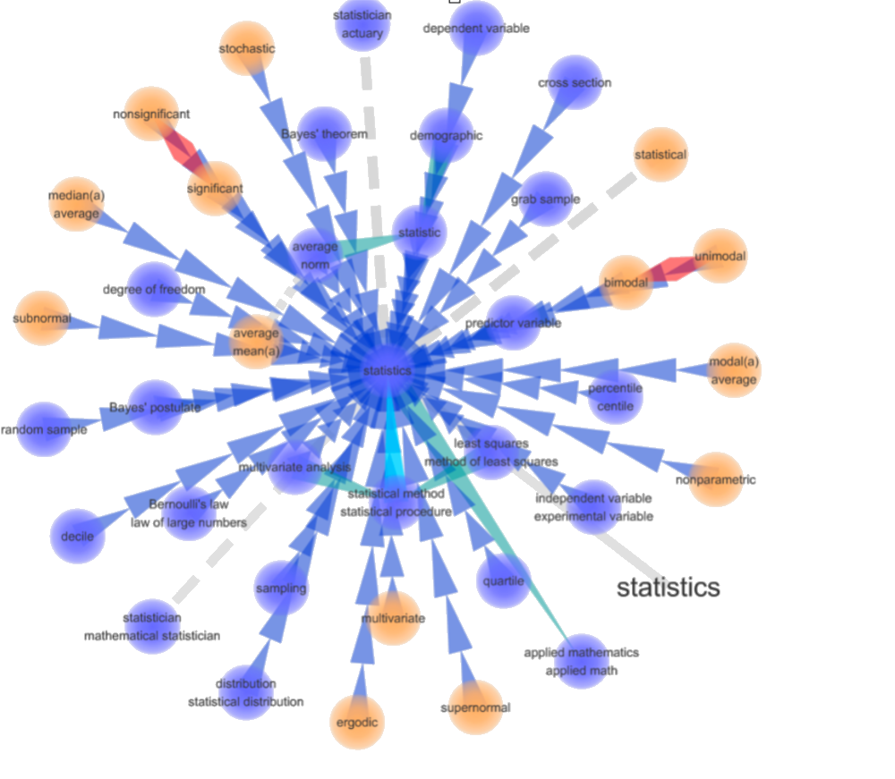
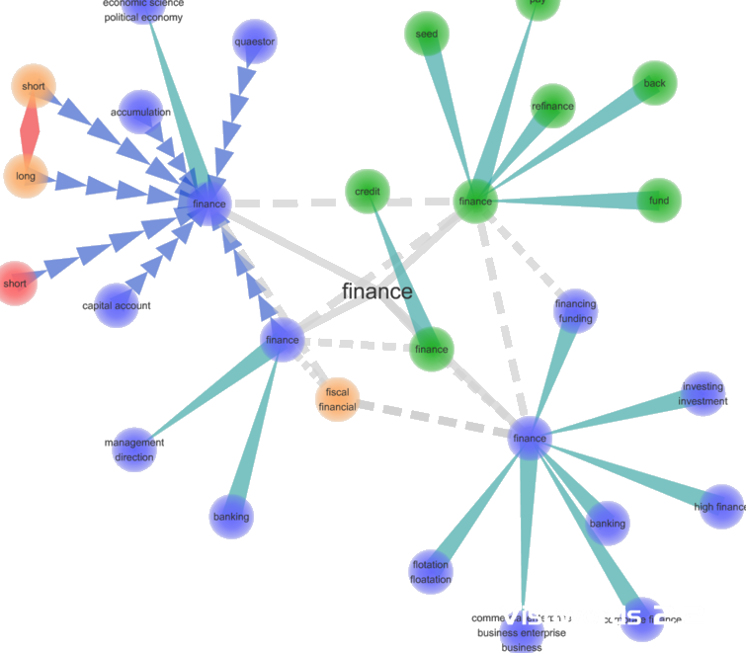
Section 2: Basic Text Analytics
Text Analytics - Dictionaries & Lexicons
Visuwords: an online graphical associative dictionary

Slide 20
Section 3: Text Classification
Text Classification
Modern text mining
Reading and understanding
Opinions into categories
Commercial applications
Sentiment extraction
Opinion Lexicon (BL), Hu and Liu (2004)
Multi-Perspective Question Answering Subjectivity Lexicon (MPQA), Wilson et al. (2005)

Slide 21
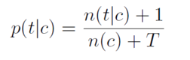
Section 3: Text Classification
Bayes classifier
Logic
use training data to define the prior probabilities of the classification
Approach
These priors are used with additional cases to determine the classification of these cases
In practice
This is how a spam filters work
Number of times a word t appears in category c
number of terms in the data
Prior probability of a word belonging to a class c
(e.g. bullish/bearish/neutral)
Total number of words in the training data in class c

Slide 22
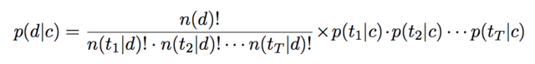
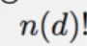
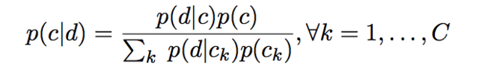
Section 3: Text Classification
Bayes classifier
The probability of seeing a given document in each category is given by the following multinomial probability:
where is the number of words in the document, and is the number of occurrences of word in the same document . These are the prior probabilities in the Bayes classifier, compute the posterior probabilities using documents from the test data.
The probabilities are computed for each document in test data as follows:

Slide 23
Section 3: Text Classification
Bayes Classifier applied
Step 1: Create lexicon, n(c) = 6
lexicon = c("buy", "sell", "hold", "good", "bad", "okay")
Step 2: Select training data (row: documents; columns: times each word in the lexicon appears in each document)
train_data = matrix( rpois(60, 3), 10, 6)
train_class = as.matrix( c(2, 3, 1, 2, 2, 1, 3, 2, 3, 3))
train_data
[,1] [,2] [,3] [,4] [,5] [,6]
[1,] 1 2 5 4 6 1
[2,] 1 5 4 3 3 3
[3,] 4 5 3 2 4 5
[4,] 0 0 6 5 2 3
[5,] 3 1 4 3 5 3
[6,] 1 3 3 2 3 6
[7,] 2 2 1 3 1 3
[8,] 3 5 2 3 2 3
[9,] 4 4 2 3 3 2
[10,] 11 3 4 2 0 2

Slide 24
Section 3: Text Classification
Bayes Classifier applied - continued
Step 3: Train model
library(e1071)
model = naiveBayes(train_data, train_class)
model
Naive Bayes Classifier for Discrete Predictors
Call:
naiveBayes.default(x = train_data, y = train_class)
Step 4: Predict classes for new data
pred = predict(model, train_data, type = "raw")
pred
1 2 3
[1,] 1.465236e-16 9.999308e-01 6.921879e-05
[2,] 3.921863e-08 3.803266e-01 6.196734e-01
[3,] 1.000000e+00 5.801637e-10 9.622133e-12
[4,] 8.312118e-10 9.999977e-01 2.256877e-06

Slide 25
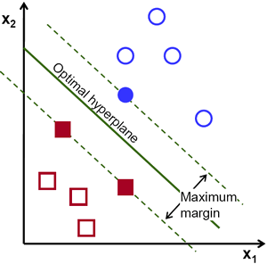
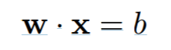
Section 3: Text Classification
Text classification - SVM Support Vector Machines
Logic
map a set of documents into a set of document categories
Approach
use hyperplanes for the maximal separation of different document categories
In practice
SVMs tend to be more flexible and deliver better predictive accuracy than Bayes classifiers
Scalar
normal vector of the hyperplane
set of points on the hyperplane

Slide 26
Section 3: Text Classification
SVM application overview
Flexible classification method
multivariate non-linear statistical technique
pattern recognition, medical diagnostics, text classification, corporate, bankruptcy analysis, credit scoring, Probability of Default (PD) calculation

Slide 27


Section 3: Text Classification
SVM - illustration
Example: company rating based on financial ratios, e.g. functions of net income, total assets, interest payments
SVM - nonlinear classification technique to produce company’s score
Company’s score transformed to PD and rating
Now important for Micro Credits webank.com

Slide 28
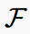
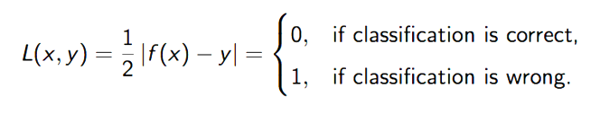
Section 3: Text Classification
SVM - loss
Nonlinear classifier function may be described by a function class fixed a priori, i.e. class of linear classifiers (hyperplanes)
Loss
Y = response = -1; +1 and X = predictor

Slide 29
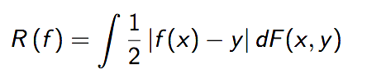
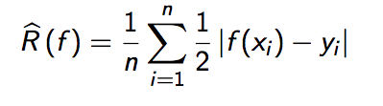
Section 3: Text Classification
SVM - expected and empirical risk
Expected risk - expected value of loss under the true probability measure
Empirical risk - average value of loss over the training set

Slide 30
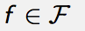
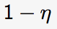
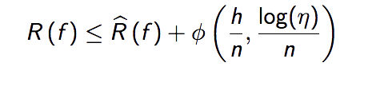
Section 3: Text Classification
SVM - VC bound
Vapnik-Chervonenkis (VC) bound - there is a function
(monotone increasing in VC dimension h) so that all
with probability hold

Slide 31
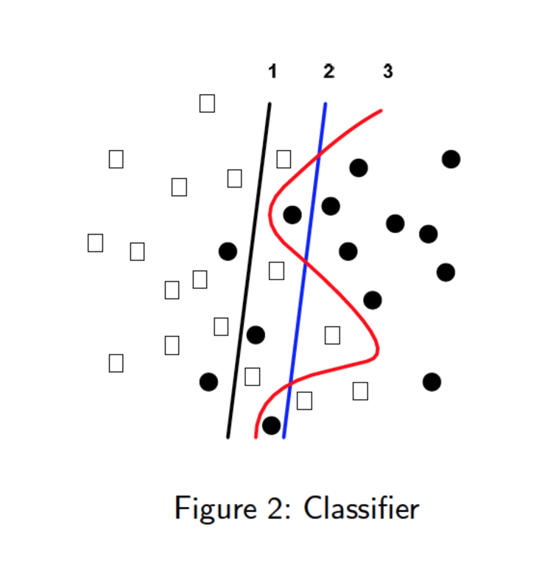
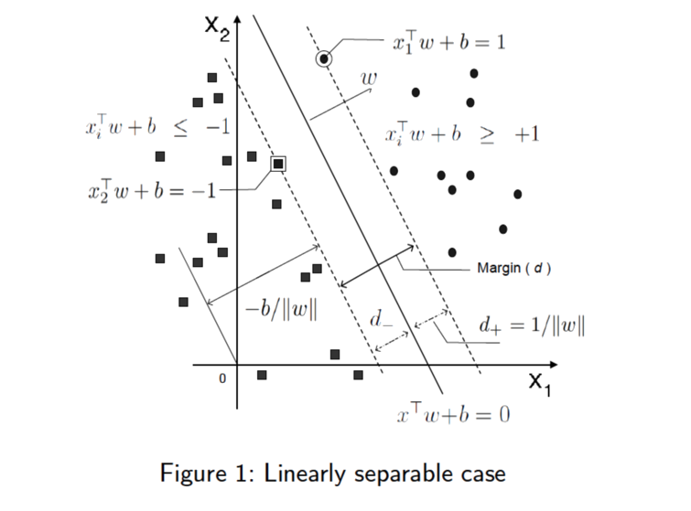
Section 3: Text Classification
SVM Illustration

Slide 32
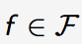
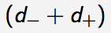
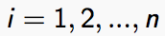
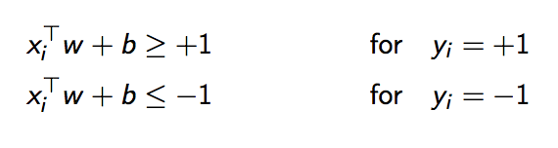
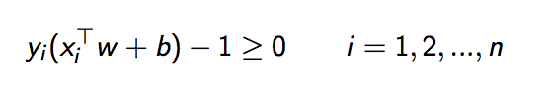
Section 3: Text Classification
SVM - VC bound minimization
Choose such that margin is maximal
No error separation - if all satisfy
Both constraints are combined into

Slide 33
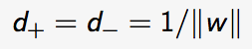
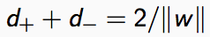
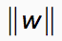
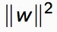
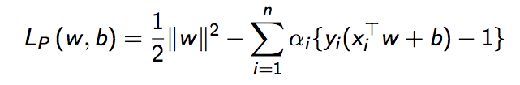
Section 3: Text Classification
SVM - VC bound
Distance between margins and the separating hyperplane is
Maximize the margin could be attained by minimizing or
Lagrangian for the primal problem

Slide 34
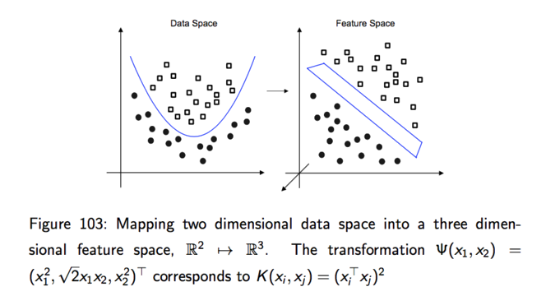
Section 3: Text Classification
SVM - Nonlinear Classification

Slide 35
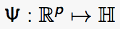
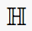
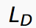
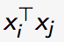
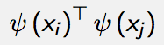
Section 3: Text Classification
SVM - Nonlinear Classification
Non-linear classifier - maps the data with a non-linear structure via a function into a very large dimensional space where the classification rule is (almost) linear
All the training vectors appearing in only as scalar products
Nonlinear SVM - transforms the scalar product to

Slide 36
Section 3: Text Classification
SVM - Simulation
Parameters of SVM are on kernel parameters and capacity C
Using stationary Gaussian kernel, for example
Generate orange peel data and spiral data
http://cbio.mines-paristech.fr/~jvert/svn/tutorials/practical/svmbasic/svmbasic_notes.pdf

Slide 37
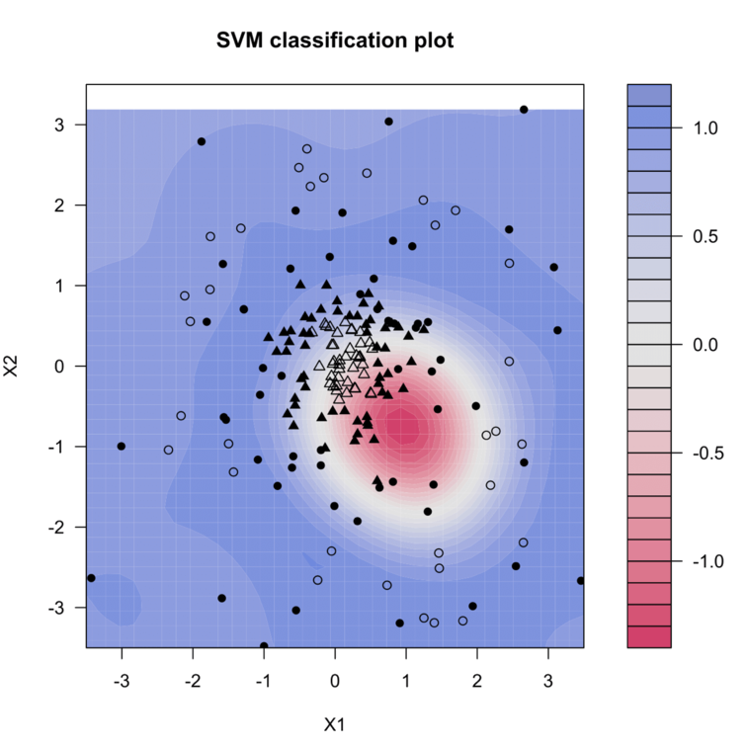
Section 3: Text Classification
Simulation: Orange Peel Data
MVAsvmOrangePeel.R

Slide 38
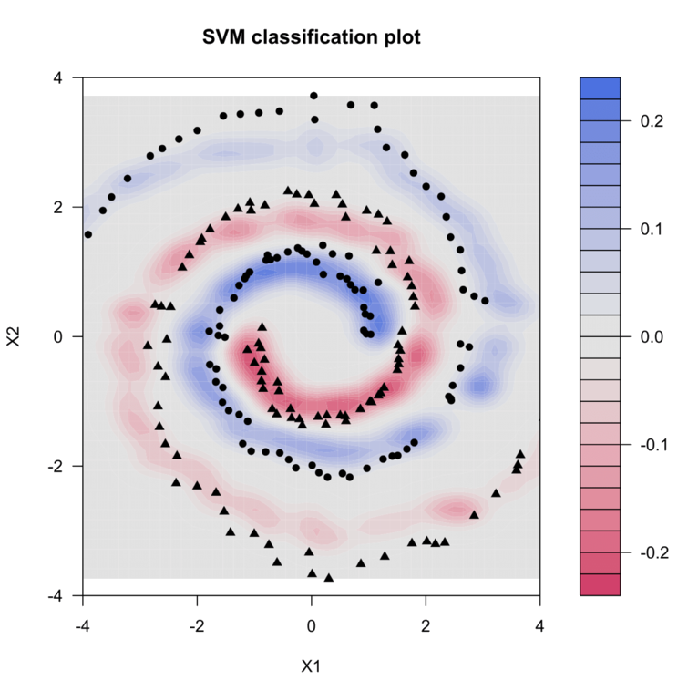
Section 3: Text Classification
Simulation: Spiral Data
MVAsvmSpiral.R

Slide 39
Section 3: Text Classification
SVM - Scoring Companies
Credit reform database - solvent (y=+1) and insolvent (y=-1)
Period - 1996 to 2002
25 financial ratio variables
Pre-processing - replace outliers with Q25-1*5IQ and Q75+1*5IQ
Example, randomly selected 50 solvent and 50 insolvent companies, predictors: Accounts Payable turnover (x24); ratio of Operating Income and Total Asset (x3)

Slide 40
Section 3: Text Classification
SVM - Scoring Companies
Using isotropic Gaussian kernel
Triangles - insolvent companies, circles - solvent companies
Colored background - score values
Blue area - the higher the score and the greater the PD

Slide 41
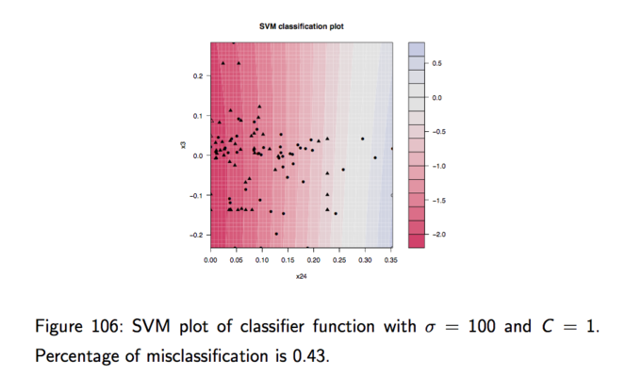
Section 3: Text Classification
SVM - Scoring Companies

Slide 42
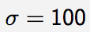
Section 3: Text Classification
SVM - Effect of parameters
Radial base is too large, SVM has trouble to classify
Reduce and (C remains the same), better classification
Increase C will decrease the distance between group

Slide 43
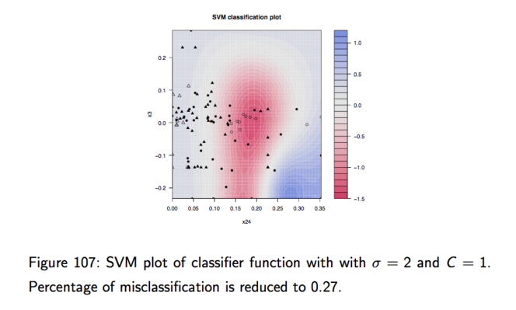
Section 3: Text Classification
SVM - Scoring Companies

Slide 44
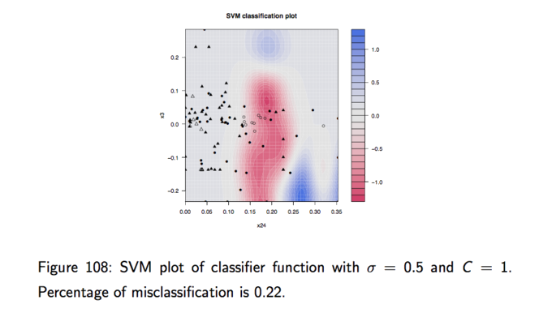
Section 3: Text Classification
SVM - Scoring Companies

Slide 45
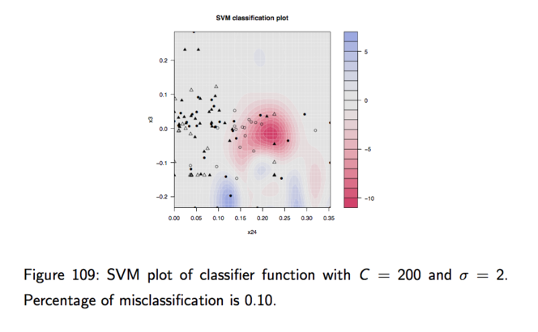
Section 3: Text Classification
SVM - Scoring Companies

Slide 46
Section 3: Text Classification
Support vector machines applied
Step 1: Train model
library(e1071)
model = svm(train_data, train_class)
model
Call:
svm.default(x = train_data, y = train_class)
Step 2: predict classes for new data
pred = predict(model, train_data, type = "raw")
pred
1 2 3 4 5
2.079014 2.920882 1.664431 2.079021 2.079063
6 7 8 9 10
1.638246 2.921028 2.921251 2.216416 2.078623
train_fitted = round(pred, 0)
train_fitted
1 2 3 4 5 6 7 8 9 10
2 3 2 2 2 2 3 2 3 2

Slide 47
Section 3: Text Classification
Word count classifiers, adjectives, and adverbs
Logic
Focus on “emphasis words” such as adjectives and adverbs (often handy when classifying emotive content)
Approach
Identify all adjectives and adverbs in the text and then only consider words that are within ±3 words before and after the adjective or adverb (Das and Chen [2007])

Slide 48
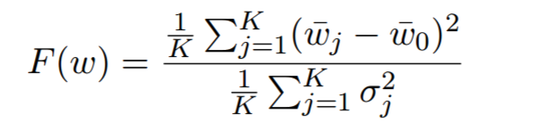
Section 3: Text Classification
Fisher’s discriminant-based word count
Logic
Some words have greater discriminating ability than others
Approach
This discriminating ability is measured by the Fisher discriminant
Step 1: Compute F(w) for each word in the text
Step 2: Weight words by their Fisher discriminant
Variance of word occurence accross goups 1...K
Variance of word occurence within a class j

Slide 49

Section 3: Text Classification
Vector distance classifiers
Logic
Any text may be represented by a vector of word frequencies
In practice:"Text mining is easy easy" =
{[text, mining, is, easy], [1,1,1,2]}
Approach
The closeness between two documents i and j is determined by their cosine distance. Identical vectors have a cosine distance of 0.
vector for document j

Slide 50



Section 4: Metrics
Metrics - assessing model classification
Disagreement
Correlations
Phase lag metric
Readability

Slide 51


Section 4: Metrics
Confusion matrix
Structure
KxK matrix for K classification categories
Rows represent real category
Correct classifications lie on the diagonal
The performance of the classification algorithm is assessed by a chi^2 statistic
Nobs under a row independence assumption
Nobs in the confusion matrix

Slide 52

Section 4: Metrics
Accuracy
Logic
Accuracy is the percentage of text that is correctly classified. This may be done in-sample or out-of sample
In practice
Accuracy ratios of 60%-70% are reasonable for text that is non-factual and contains poor language and opinions
sum of diagonal
is confusion matrix
sum of all entries in the
confusion matrix

Slide 53
Section 4: Metrics
False positives
Logic
Improper classification is worse than a failure to classify
When n > 2, some classification errors are worse than others
An ordering of categories is useful so that a false classification into a near category is not as bad as a wrong classification into a far (diametrically opposed) category.
Approach
Simple count
Weighted count (by nearness of wrong category) of false classifications divided by total classifications undertaken

Slide 54

Section 4: Metrics
Sentiment error
Logic
Compute an aggregate measure of sentiment error
Aggregation is useful because it allows classification errors to cancel out each other
Approach
Sentiment error is the percentage difference between the computed aggregate sentiment, and the value we would obtain if there were no classification error
In practice
Sentiment aggregation gives a better relation between news and stock returns (Leinweber and Sisk [2010] )

Slide 55
Section 5: Applications
Empirics
Predicting Market Movement
Quality (meaning) and quantity (volume) of text
Naive Bayes algorithm for classification, implemented in the Rainbow package of Andrew McCallum [1996]
Predicting risk, volatility, volume
Message posting volume, Wysocki [1999]
Significant relationship between message volume and volatility, Das and Chen [2007]
Message volume and trading volume are related, Lu et al. [2010], Zhang and Skiena [2010]
Text Mining Company Reports
Public Data and Network Modeling

Slide 56
Section 5: Applications
Twitter and News Based Prediction
Sentiment construction and prediction
Ease of accessing Twitter talk - API interface provided by Twitter
These microblog posts exhibit different language usage than standard
mood scoring might require specific lexicons
TrendMiner, Pervin et al. [2013]
Uncover trending topics on Twitter
Tweets reference news items, aggregate more than just short statements
Tweets to the stock market
Bollen et al. [2010] - the Dow Jones Industrial Average (DJIA)
Google-Profile of Mood States (GPOMS) - takes a view that sentiment is more multifaceted than just positive and negative - measures mood on six dimensions: {Calm, Alert, Sure, Vital, Kind, Happy}

Slide 57


Section 5: Applications
Twitter and News Based Prediction
Zhang & Skena [2010]
They use Twitter feeds, over 500 nationwide newspapers, RSS feeds from blogs and LiveJournal blogs to compute two metrics
Logunov [2011] - Naive Emoticon Classification
Encode sentiment
Four types of emoticons are considered: Happy (H), Sad (S), Joy (J), and Cry (C)

Slide 58

Section 5: Applications
Twitter and News Based Prediction
Sprenger & Welpe [2010] - a bullishness index
Tweets are associated to contemporaneous abnormal stock returns
Message volume is not related to abnormal returns
The bullishness index is defined as in Antweiler & Frank [2004]
Rao & Srivastava [2012]
They analyse more than 4 million tweets for the DJIA, NASDAQ-100 and 11 other big cap technology stocks
Twitter sentiment and returns have an 88% correlation
Bar-Haim et al. [2010]
Build an algorithm to identify expert investors whose tweets are weighted more highly
Divide tweets into questions, noise or obscure item, facts and opinions

Slide 59

Section 5: Applications
Public Data & Network Modeling
Figure 5.1: The data map in the IBM Midas system for the
entities being populated with data from corporate filings

Slide 60

Section 5: Applications
Public Data & Network Modeling
Figure 5.2: The 2005 loan network in the IBM Midas system
for the entities being populated with data from corporate fillings.

Slide 61

Section 5: Applications
Public Data & Network Modeling
Figure 5.2: The 2006 to 2009 loan networks in the IBM Midas system
for the entities being populated with data from corporate fillings.

Slide 62

Section 5: Applications
News Analytics
Figure 5.3: Insider time lines from the IBM Midas system for the
entities being populated with data from corporate fillings. The top one
shows insider holdings, and the bottom one shows insider transactions.

Slide 63
Smart Data Analytics
Wolfgang K. Härdle
Cathy Yi-Hsuan Chen
Linxi Wang

